Slide 1
(Senti)ment Analysis
PYTHON PROJECT

Slide 2



What Senti Has to offer
Twitter sentiment analysis
Text Sentiment Analysis
Udemy Course’s reviews sentiment analysis

Slide 3
SCOPE of the Project
We are providing the users with a single platform to perform sentiment analysis
on various modules(3 at the moment).
Absolutely no coding platform for the user, at the very least user has to input the
topic he want a sentiment analysis to be performed on or at the very most user has
to upload a text file they need to analyse the sentiment of.
Students who wants to explore online courses and don’t want to go through the
pain of reading the reviews about the courses can use this platform and with just a click
they can have the overall sentiment of the reviews.

Slide 4
Business benefit
Other platforms that provides these kind of services
Tweeter sentiment analysis
NCSU Tweet Sentiment Visualization App, Revealed Context , QuickSearch etc.
Text Analysis
Opentext, RapidMiner
Platforms that provide both the services ? A lot less
TARGET USERS.
Anyone and everyone who want to gain the public sentiment on certain
topics(political, sports, products, latest news etc.)
Users who want to analyze the sentiment of a specific data and doesn't want
to write the code.
And at last all the online learners who needs to know how other people
have reacted to the course they want to opt in

Slide 5
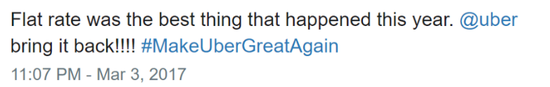


What is sentiment analysis
Sentiment analysis is contextual mining of text which identifies and extracts subjective information in source material, and helping a business to understand the social sentiment of their brand, product or service while monitoring conversations.

Slide 6
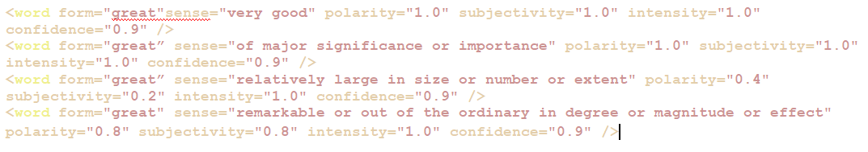
TEXTBLOB
TextBlob calculates 3 things to calculate the sentiment of a text
Polarity (-1 to 1)
Subjectivity (0 to 1)
Intensity (0.5 to 2)
Example of textblob lexicon

Slide 7

TEXTBLOB
Textblob uses the averaging method while calculating the single word sentiment.
TextBlob doesn't not handle negation, and that ain't nothing!.
Negation multiplies the polarity by -0.5
TextBlob also handles modifier words!
Recognizing a modifier word, TextBlob will ignore polarity and subjectivity and just use
intensity to modify word
Negation combines with modifiers in an interesting way: in addition to multiplying by -0.5 for the polarity, the inverse intensity of the modifier enters for both polarity and subjectivity

Slide 8
Twitter Sentiment Analysis
User Input
1. Topic name
2. Number of tweets
Twitter API
Connecting to Twitter and fetching tweets
1. English tweets only
2. No retweets
3. Recent tweets
TEXT
BLOB
Calculating the sentiment
<0. Negative
0. Neutral
>0. Positive
Visualization

Slide 9
Text Sentiment Analysis
User uploads a text file
1. Currently limited to csv file
Loading the text file in python
Display error message
Currently limited to csv file
Text should be present in the
first column
If any of the constraint fails
TEXT
BLOB
Calculating the sentiment
<0. Negative
0. Neutral
>0. Positive
Visualization

Slide 10
Udemy Course’s reviews sentiment analysis
User input
Exact course name
Checks if the course is available
Go to the required course page and fetches the reviews
Display not available message
NO
Yes
TEXT
BLOB
Calculating the sentiment
<0. Negative
0. Neutral
>0. Positive
Visualization

Slide 11
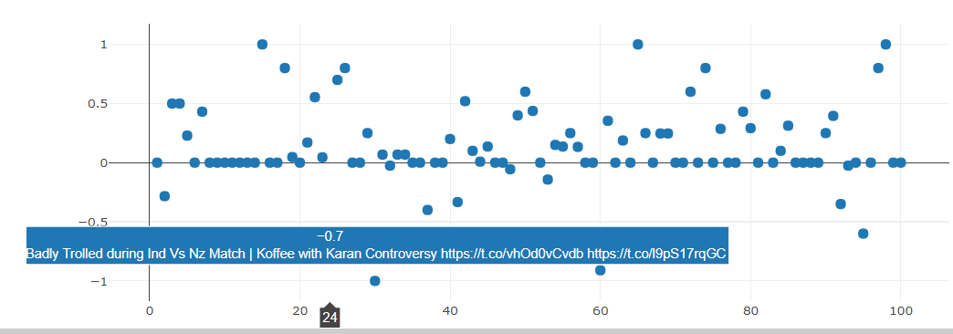
Visualizations that Senti offers(as of now)
Scatter plot of the sentiment polarity in chronological
order of the tweets.

Slide 12
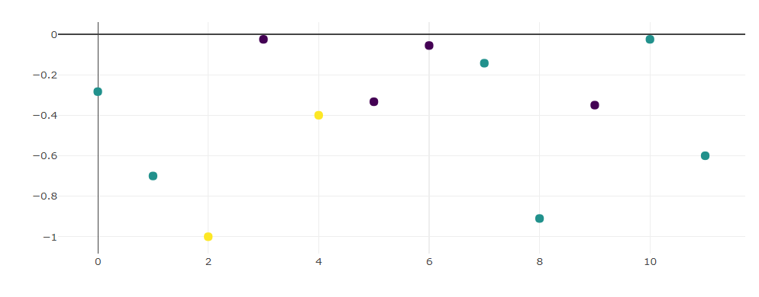
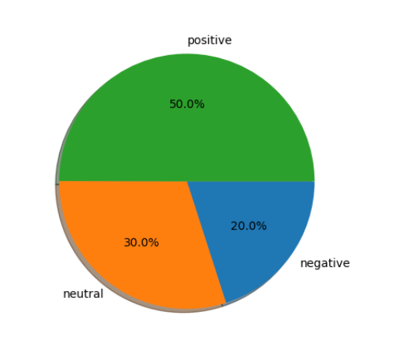
Pie chart of the overall sentiment percentages.
Scatter plot of the tweets with negative plolarity
Which has been clustered(3 clusters) together considering
The document similarity using cosine similarity.
(TFIDF)

Slide 13
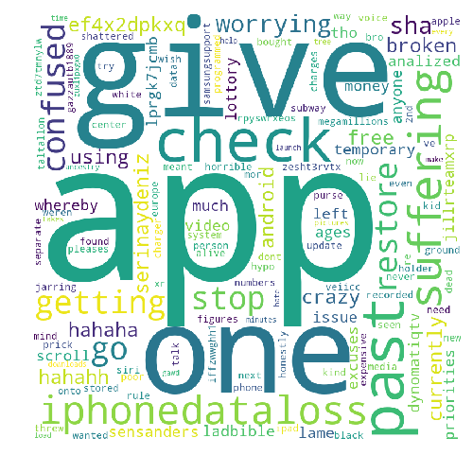
Visualizations that Senti offers(as of now)
Word clouds for the entire
Data(tweets, text, reviews) and separate
Word cloud for the data having negative
Sentiment.

Slide 14
Future SCOPE of the Project
Interactive Visualizations.
Support for more social medias websites.
Support for more online courses websites.
Including more Modules to perform sentiment analysis on.
Deeper analysis(eg. clustering of the tweets, comments pertaining to specific topics inside the data.)
Support for more file types to be analysed.

Slide 15
THANK YOU

